Slide 1
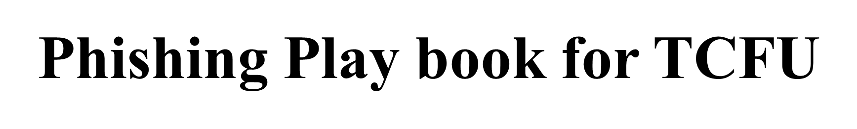

Uche Obiora
Uche.Obiora@TowerFCU,org

Slide 2

Introduction
Phishing is a type of cyber attack that involves tricking individuals into providing sensitive information by masquerading as a trustworthy entity.
This playbook aims to provide a comprehensive guide to understanding, detecting, and responding to phishing attacks to protect Tower Federal Credit Union from potential threats.

Slide 3

Table of Contents
Understanding Phishing
Phishing Attack Lifecycle
Detection and Prevention
Response and Mitigation
Phishing Simulation and Training
Phishing Flow Chart Diagram
Phishing Flow Chart Steps

Slide 4
Understanding Phishing
Definition of phishing: Phishing is a cyber attack where attackers masquerade as trustworthy entities to steal sensitive information.
Types of phishing attacks: Spear phishing, Whaling, Vishing, Smishing.

Slide 5
Spear phishing is a targeted form of phishing where the attacker customizes the attack to a specific individual or organization.
Whaling is a type of phishing attack specifically aimed at high-profile targets like executives, CEOs, and other senior management. The goal is often to gain access to highly sensitive corporate data.
Vishing (Voice Phishing) involves attackers using phone calls to deceive individuals into providing confidential information, often pretending to be from legitimate organizations like banks or government agencies.
Smishing (SMS Phishing) involves sending fraudulent text messages to trick individuals into clicking on malicious links or providing sensitive information.

Slide 6
Phishing Attack Lifecycle
Initial Contact: Attackers send malicious emails or messages.
Exploitation: Victims click on links or download attachments.
Execution: Malicious code is executed.
Exfiltration: Sensitive data is stolen, or victim is infiltrated.

Slide 7
Detection and Prevention
Technical Controls: Email filtering, Anti-phishing software, DNS filtering.
User Awareness and Training: Regular training sessions, Phishing simulations.
Email Filtering and Analysis: Analyzing email headers, attachments, and URLs.

Slide 8

Response and Mitigation
Incident Response Plan: Steps to take when a phishing attack is detected.
Communication Strategy: How to communicate with affected parties.
Recovery Steps: Restoring systems, changing passwords, and notifying users.

Slide 9

Phishing Simulation and Training
Conducting Simulated Phishing Attacks: Simulating phishing attacks to train employees.
Measuring Effectiveness: Assessing the results of simulations and improving training.

Slide 10

Phishing Flowchart Diagram

Slide 11
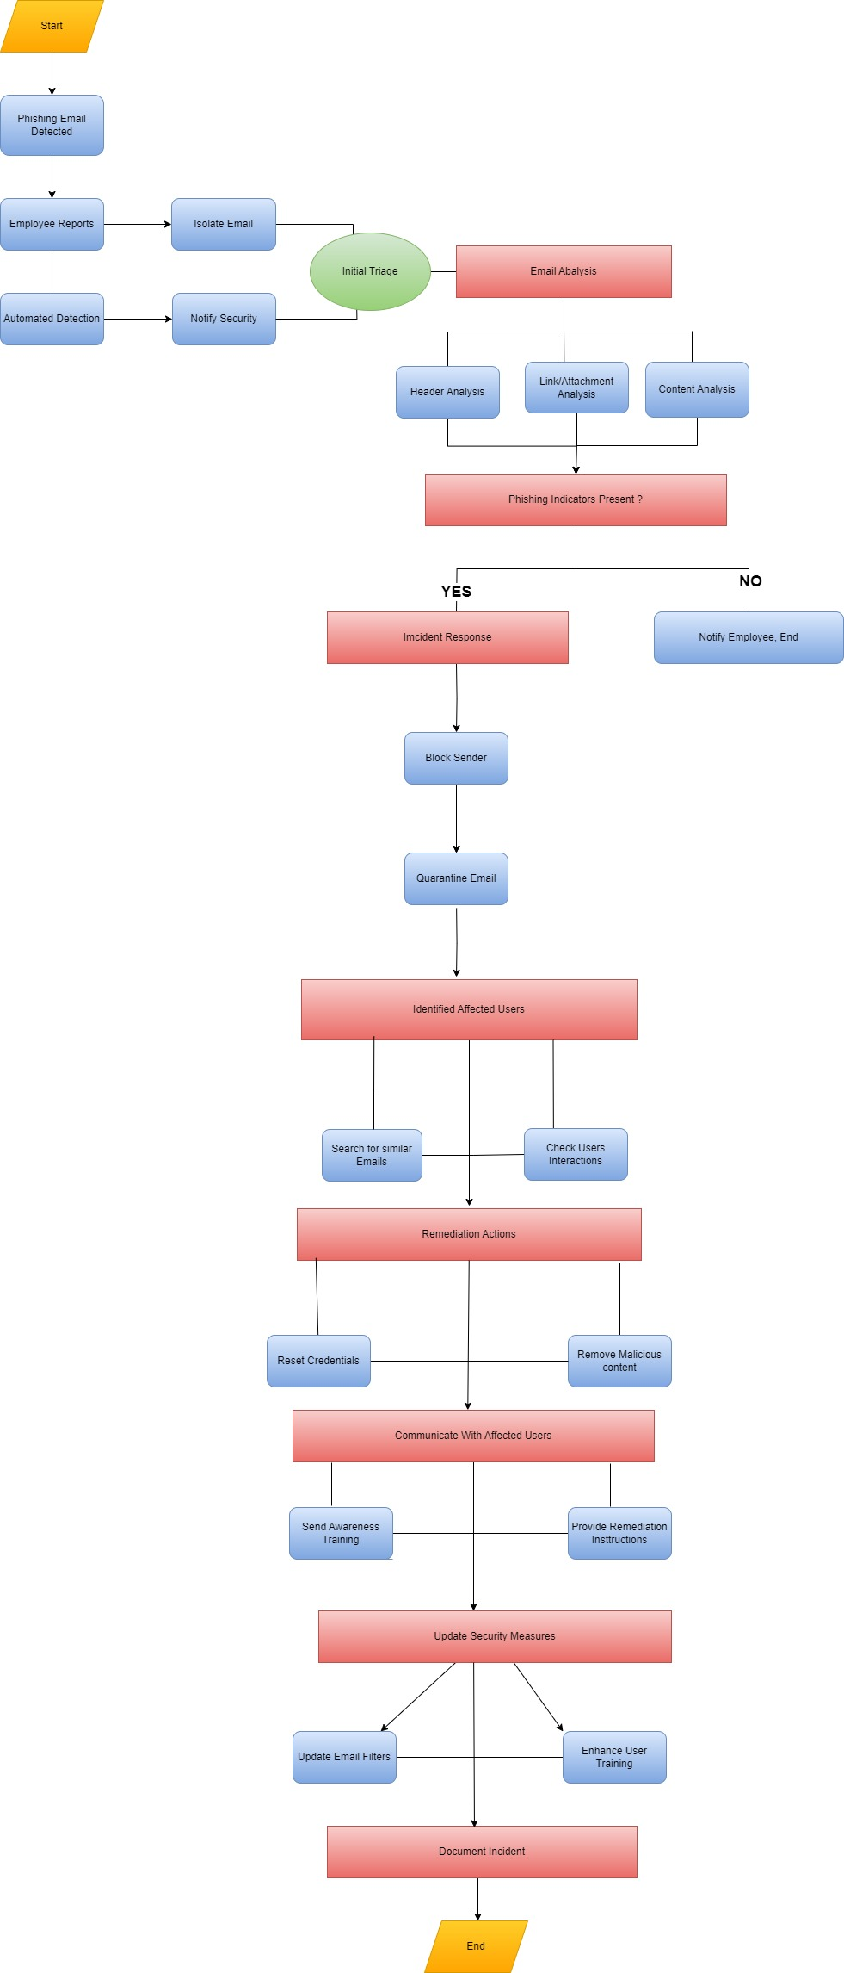

Slide 12


Slide 13
Detailed Explanation of the Phishing Playbook Process
1. Start
Objective: Initiate the process when a phishing email is detected or reported.
2. Phishing Email Detected
Methods:
Employee Reports Phishing Email: Employees identify and report suspicious emails.
Automated Detection: Use of tools like an Email Security Gateway to detect phishing attempts.

Slide 14
3. Initial Triage
Objective: Perform initial assessment to understand the severity and scope.
Steps:
Isolate Email: Ensure the suspicious email is quarantined to prevent further damage.
Notify Security Team: Alert the security team about the detected phishing email for further action.
4. Email Analysis
Objective: Thoroughly examine the email to determine if it is indeed a phishing attempt.
Steps:
Header Analysis: Check the email headers for spoofing or malicious senders.
Link/Attachment Analysis: Analyze any links or attachments for malicious content.
Content Analysis: Inspect the email content for phishing indicators such as urgency, requests for sensitive information, or unusual language.

Slide 15
5. Phishing Indicators Present?
Decision Point:
Yes: If phishing indicators are present, proceed to Incident Response.
No: If no indicators are found, notify the employee and end the process.
6. Incident Response
Objective: Take immediate actions to mitigate the threat.
Steps:
Block Sender: Block the email address or domain from which the phishing email originated.
Quarantine Email: Ensure the email is removed from all user inboxes and quarantined.

Slide 16
7. Identify Affected Users
Objective: Identify and assess users who might have interacted with the phishing email.
Steps:
Search for Similar Emails: Check for similar phishing emails in the system.
Check User Interactions: Determine if any users clicked on links or downloaded attachments.
8. Remediation Actions
Objective: Mitigate the impact on affected users.
Steps:
Reset Credentials: Reset passwords or credentials for users who interacted with the phishing email.
Remove Malicious Content: Ensure any downloaded malware or malicious content is removed from affected devices.

Slide 17
9. Communicate with Affected Users
Objective: Inform and educate users who were affected or at risk.
Steps:
Send Awareness Training: Provide phishing awareness training to improve future detection by users.
Provide Remediation Instructions: Give instructions on what steps users should take if they interacted with the phishing email.
10. Update Security Measures
Objective: Strengthen overall security to prevent future phishing attacks.
Steps:
Update Email Filters: Adjust and enhance email filtering rules and settings.
Enhance User Training: Provide updated training materials and sessions to educate users on new phishing tactics.
11. Document Incident
Record the details of the incident, the response actions taken, and any lessons learned for future reference
END

